Slide 1
Survival Analysis
Tomas Bencomo and Kyle W. Singleton, PhD

Slide 2
Roadmap
Statistics Review
Designing the Analysis
Analysis Methods
Interpreting Statistics

Slide 3
Why Give This Talk?
“To consult the statistician after an experiment is finished is often merely to ask him to conduct a post mortem examination. He can perhaps say what the experiment died of”
- Ronald Fisher

Slide 4
Hypothesis Testing Evaluates Evidence
Define hypotheses
H₀: Null hypothesis
T, Z, Proportion, Mean
Determine effect size/power
H₁: Alternative hypothesis
Determine test statistic
Etc.
Collect and prepare data
Compute statistic
Get p-value
Analyze evidence
Don't dichotomize the p-value

Slide 5
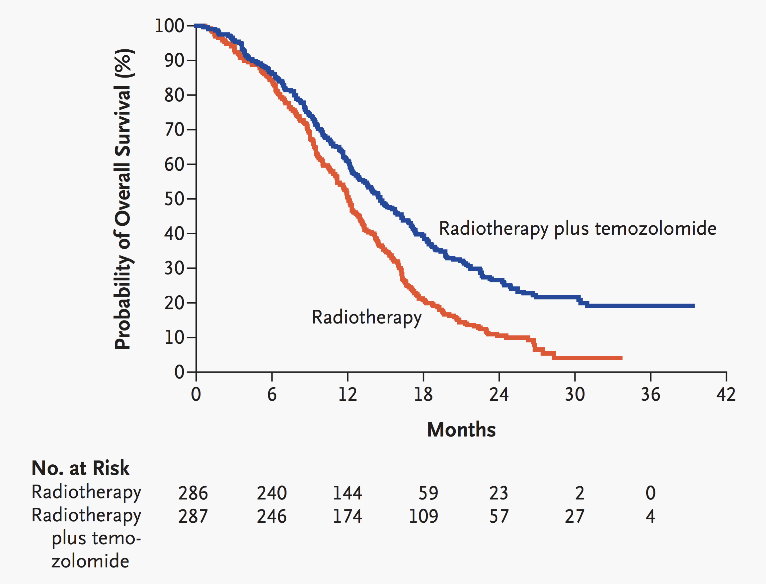
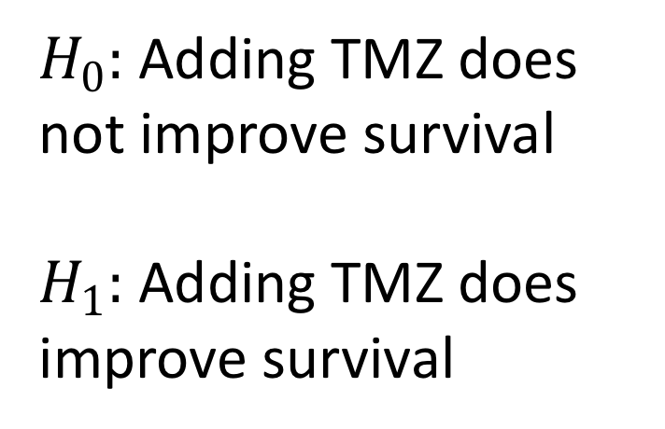
Hypothesis in Survival
$H_{0}:$ Adding TMZ does not improve survival
$H_{1}:$ Adding TMZ does improve survival
Stupp R et al. N Engl J Med 2005;352:987-996.

Slide 6
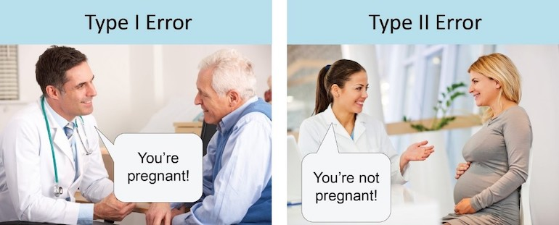

Hypothesis Tests Can Make Mistakes
$H_{0}$: The patient is not pregnant
$H_{1}$: The patient is pregnant

Slide 7
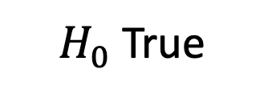
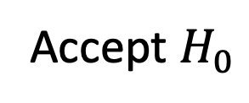
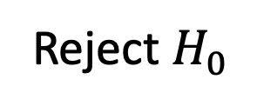
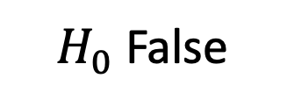
Decision Errors
$H_{0}$True
$H_{0}$False
We decide to:
Reject $H_{0}$
False Positive
Type I Error
True Negative
True Positive
False Negative
Type II Error
Accept $H_{0}$

Slide 8
Experimental Design Is Critical
Observational Study
Collect data without intervening
Confounding and covariate imbalance major concern
Notorious for mixed results
Randomized Trial
Randomly assign patients to different groups
Randomization deals with covariate imbalances
Gold standard of evidence in medicine

Slide 9
Observational Data Is Messy
UK Biobank: Cardiac MRI saves lives?
No Cardiac MRI
Has Cardiac MRI
James Pirruccello Tweetorial on UK Biobank Immortal Time Bias 2019

Slide 10
Observational Data Is Messy
What changed?
Count lifespan from time of MRI to death, the signal disappears
Has Cardiac MRI
Observational studies have lots of issues that statistical tests won’t catch! Don’t blindly analyze data
No Cardiac MRI

Slide 11

Statistical Power
Power is probability we reject $H_{0}$ when $H_{1}$ is true
How often do we find effects that actually exist
Inversely related to rate of Type II errors
Power = Type II Error

Slide 12
Let’s Get Real About Power
Assume treatment improves survival by 25% (HR = .75)
GBM almost always lethal - assume 90% of patients die
50-50 split between treatment and control groups
Need lots of patients to have any chance of finding effect!
Sample | Power
20 | 9%
100 | 25%
400 | 73%
800 | 95%
http://powerandsamplesize.com/Calculators/Test-Time-To-Event-Data/Cox-PH-2-Sided-Equality

Slide 13
Designing the Analysis
The most important part!

Slide 14
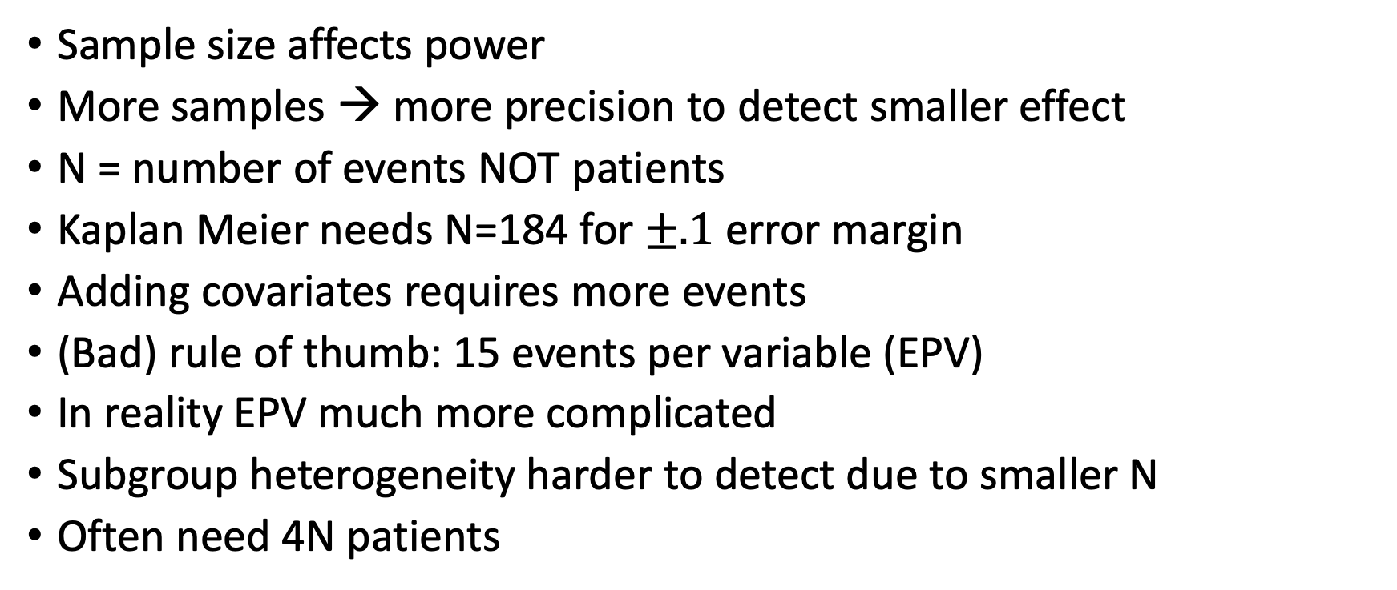
Sample Size Is Important
Sample size affects power
More samples → more precision to detect smaller effect
N = number of events NOT patients
Kaplan Meier needs N=184 for $±.1$ error margin
Adding covariates requires more events
(Bad) rule of thumb: 15 events per variable (EPV)
In reality EPV much more complicated
Subgroup heterogeneity harder to detect due to smaller N
Often need 4N patients

Slide 15
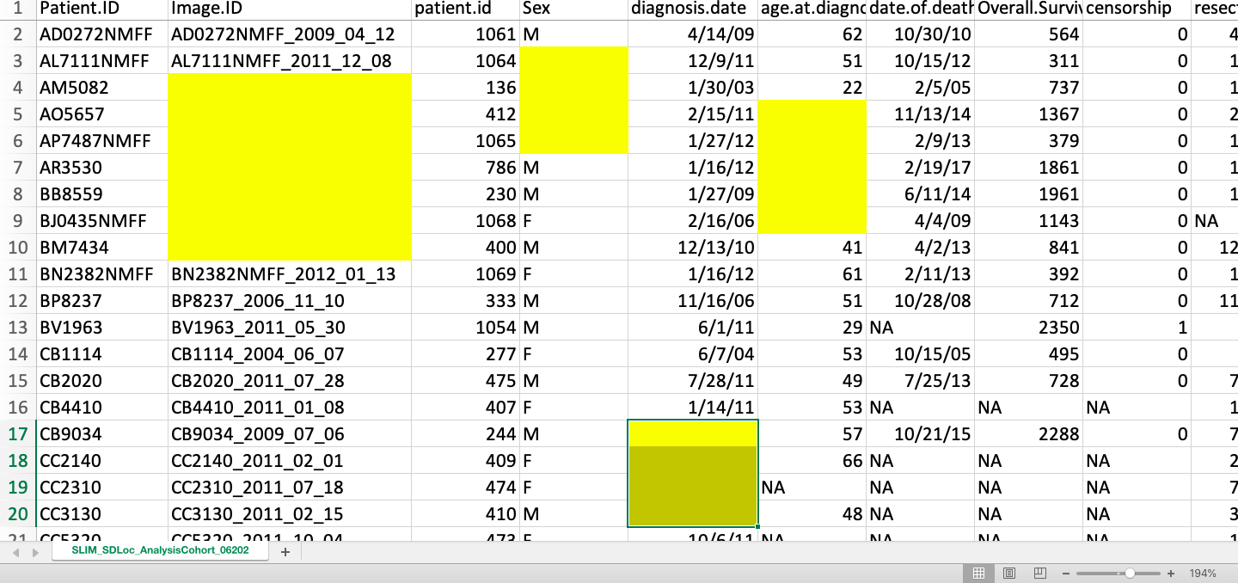
Don’t Discard Patients Missing Data
Missing data decreases sample size
Larger sample → better power
Ask why this data is missing – bias may be present
Example: Patients missing labs b/c died before labs could be collected
Simply excluding these patients could bias results
Before fixing data, explore patterns in missing variables
Think about if data is missing at random (MAR) or informative missing (MI)

Slide 16
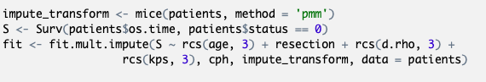
Imputation Gives Us The Power
Idea: Can we guess these missing values?
Imputation lets us guess data that is MAR
Better to guess missing values than reduce sample size
MICE imputation guesses data from non-missing data
Imputing multiple times maintains inference validity

Slide 17
Imputation Guidelines
How much is missing? | Recommendations
Less than 3% | Median imputation or exclude patients with missing data
Greater than 3% | MICE with max(5, 100x) imputations
Multiple predictors frequently missing | Sensitivity analysis with more imputations

Slide 18
Univariate Feature Selection is Bad
Common to screen variables with univariate Cox
People then only include significant variables in final model
This is a form of stepwise variable selection
9/10 of statisticians agree: don’t use stepwise variable selection!
Attiyeh et al. 2004

Slide 19
What Variables Do We Include in Our Model?
Sample size can limit number of variables to include
Variable selection procedures can impact inference
Select features incorrectly → exaggerate results
https://xkcd.com/1838/

Slide 20
Stepwise Selection Wrecks Inference
Univariate selection highly dataset dependent
Doesn’t adjust for covariates – potential for misleading signal
Univariate selection overexaggerates p-values and CIs in “full” model
Little statistical theory to support

Slide 21
How To Choose Features
Proper selection strategies:
Domain expert specifies relevant variables
Use all variables and apply shrinkage
Data reduction blinded to response
Leave insignificant in model – still add to predictions
Think about relevant confounders
Don’t Make Me Choose!
Akash Desarda – TowardsDataScience

Slide 22
Analyzing Our Data
The fun part!

Slide 23
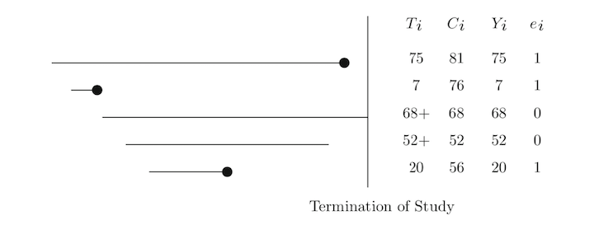
Survival Analysis
Measuring time to an event
Death, Myocardial infarction, Tumor recurrence, Rubber band failure
Patients either:
Experience the event
Are censored before the event is observed (lost to follow-up)
Coded as 1 = event and 0 = censored
Analyzing time survived vs binary dead/alive increases power
http://www.alphabetastats.com/?page_id=265

Slide 24
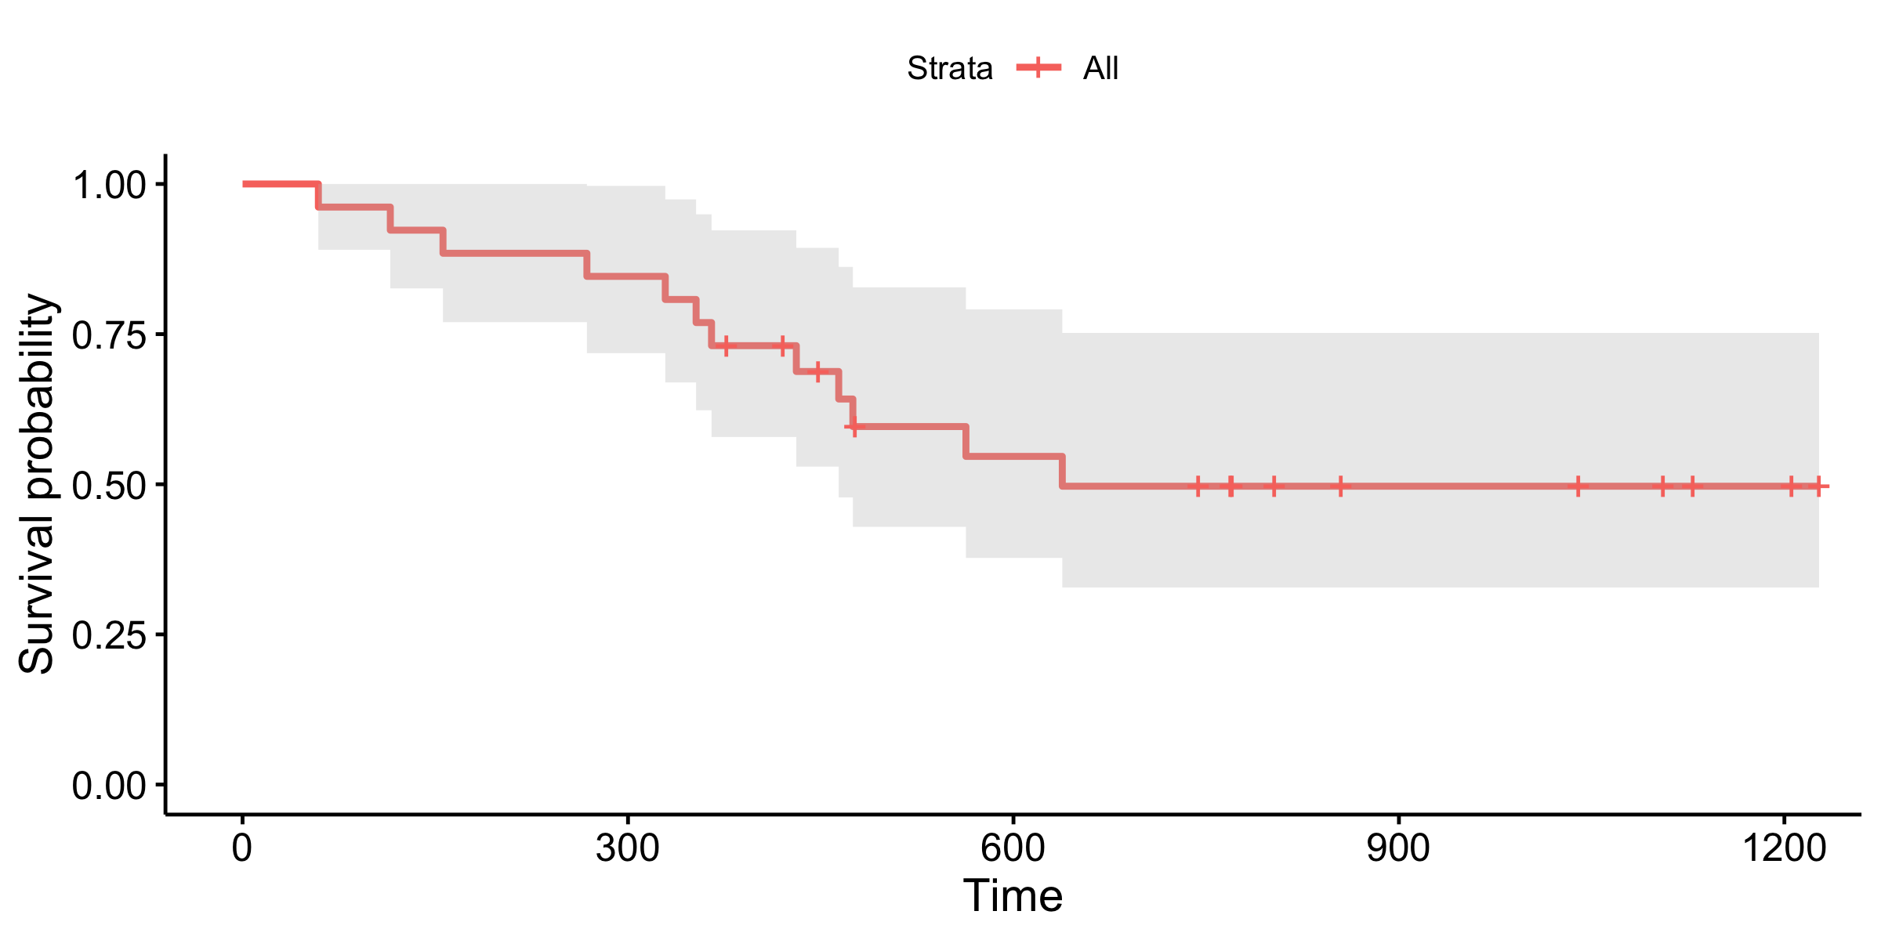
Kaplan-Meier Estimate
Computes probability of event at time t
Needed to handle censoring
Great for summary statistics describing patient prognosis

Slide 25
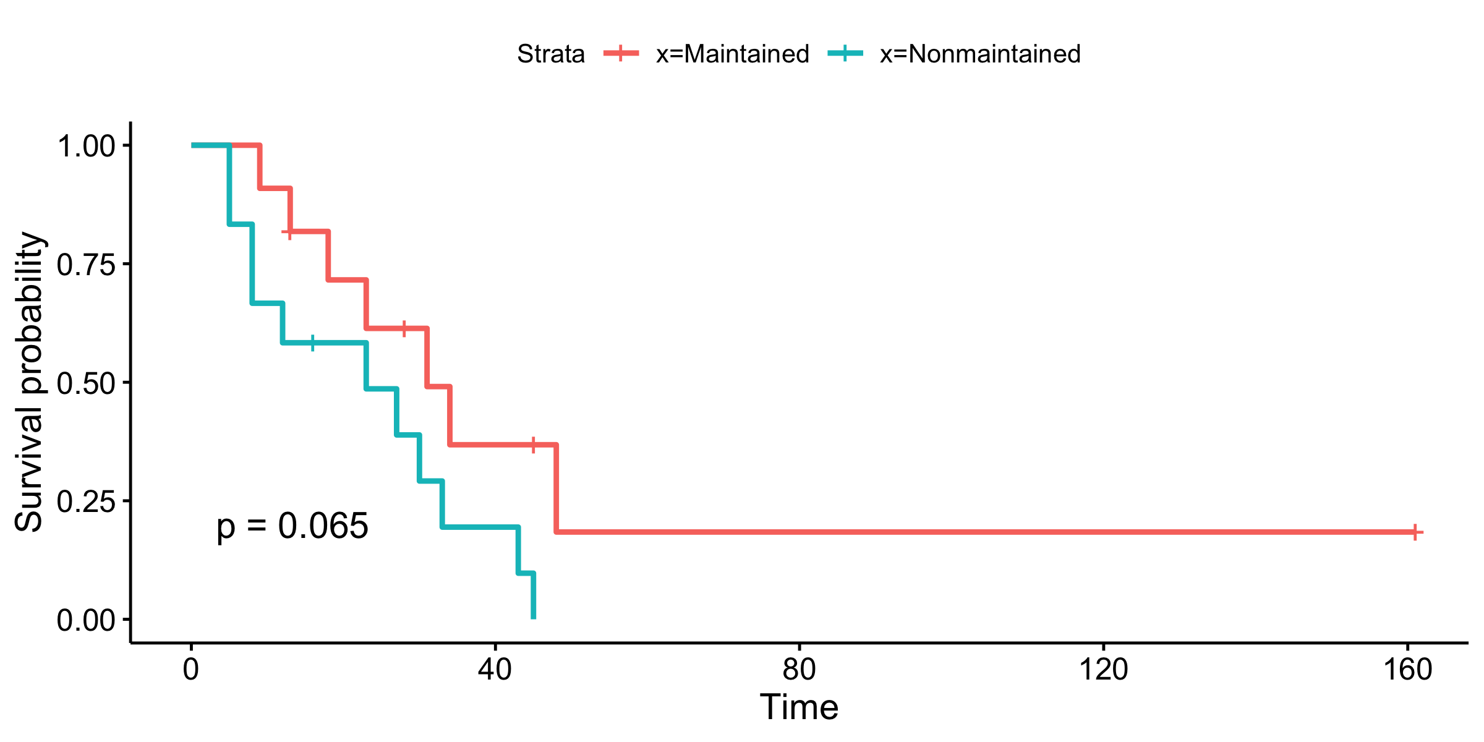
Kaplan-Meier compares survival difference
Log rank test - Test to compare survival between 2 groups

Slide 26
Should I use a Kaplan-Meier?
Yes!
No!
I have a discrete variable
Patients were randomized
I want to show summary statistics
Examples
Male vs. Female
No treatment vs. treatment
Treatment A vs. B vs. C
I have a continuous variable
My variable is observational
I need to adjust for other variables
Examples
Age

Slide 27
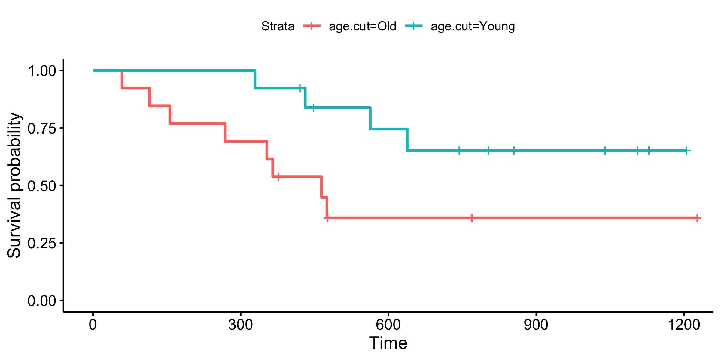
Dichotomization is the root of all evil
Discards lots of info decreasing power
Cutpoints are often arbitrary
Median? Mean?
What is high? What is low?
What is old? What is young?
What is fast? What is slow?
Cutpoints often don’t reproduce

Slide 28
Let’s Talk Iterative Kaplan-Meier
Different cuts show opposite signal in two cohorts!
Repeated testing inflates Type I error
Dichotomization requires more patients to find effect
No statistical literature on procedure
MCMC simulation needed to correct p-values
p=0.0067
Proportion Surviving
Survival Days Since Start of CAR T
Iterative Kaplan Meier should be avoided
Proportion Surviving
p=0.09
Use Cox regression instead
Survival Days Since Start of CAR T

Slide 29
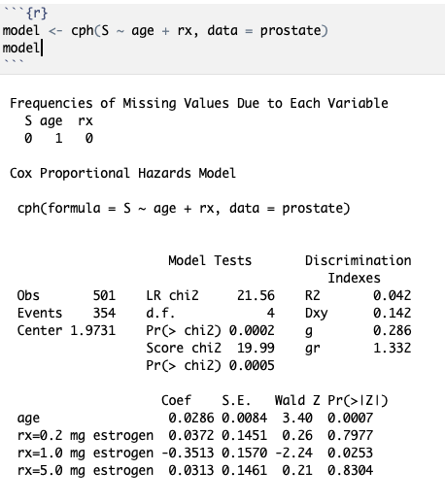
Cox Proportional Hazards Regression
Example: cph function from rms package
Multiple regression model
Model continuous variables
Account for nonlinearity
Adjust for covariates
Make risk predictions
Addresses many limitation of Kaplan-Meier estimates

Slide 30
Regression 101
Univariate
Surv(time, status) ~ a
Surv(time, status) ~ b
Multivariate
Surv(time, status) ~ a + b + c
w/ interactions
Surv(time, status) ~ a + b + c + b*c
w/ non-linear
Surv(time, status) ~ rcs(a) + b + c + b*c

Slide 31
Interpreting Cox Model
Coef = ln(HR)
S.E. = Standard Error
Pr(>[Z]) = p-value
HR = 1: No difference
HR < 1: Better survival
HR > 1: Worse survival
Beware HR vs ln(HR) scale

Slide 32
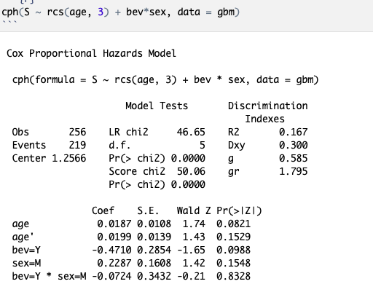
Patient Heterogeneity: Subgroup Analysis
Different treatment effect in different groups
Use interaction term to test for heterogeneity
Check for significance with anova()
If significant must interpret effects differently!

Slide 33
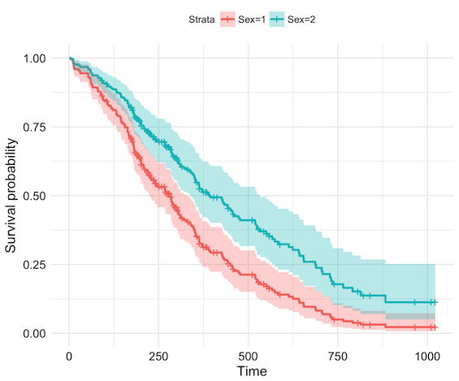
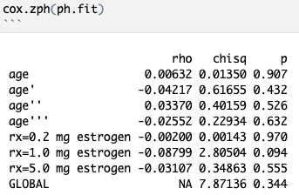
Check your model’s assumptions
Cox assumes hazard ratio constant over time (proportional hazards)
If PH not met:
Try non-linear fits for continuous variables
Stratify by variable
Time dependent interaction
Switch to AFT models

Slide 34

Check your model’s assumptions
Cox assumes hazard ratio constant over time (proportional hazards)
If PH not met:
Try non-linear fits for continuous variables
Stratify by variable
Time dependent interaction
Switch to AFT models
Don’t Cross Streams (Curves)!

Slide 35
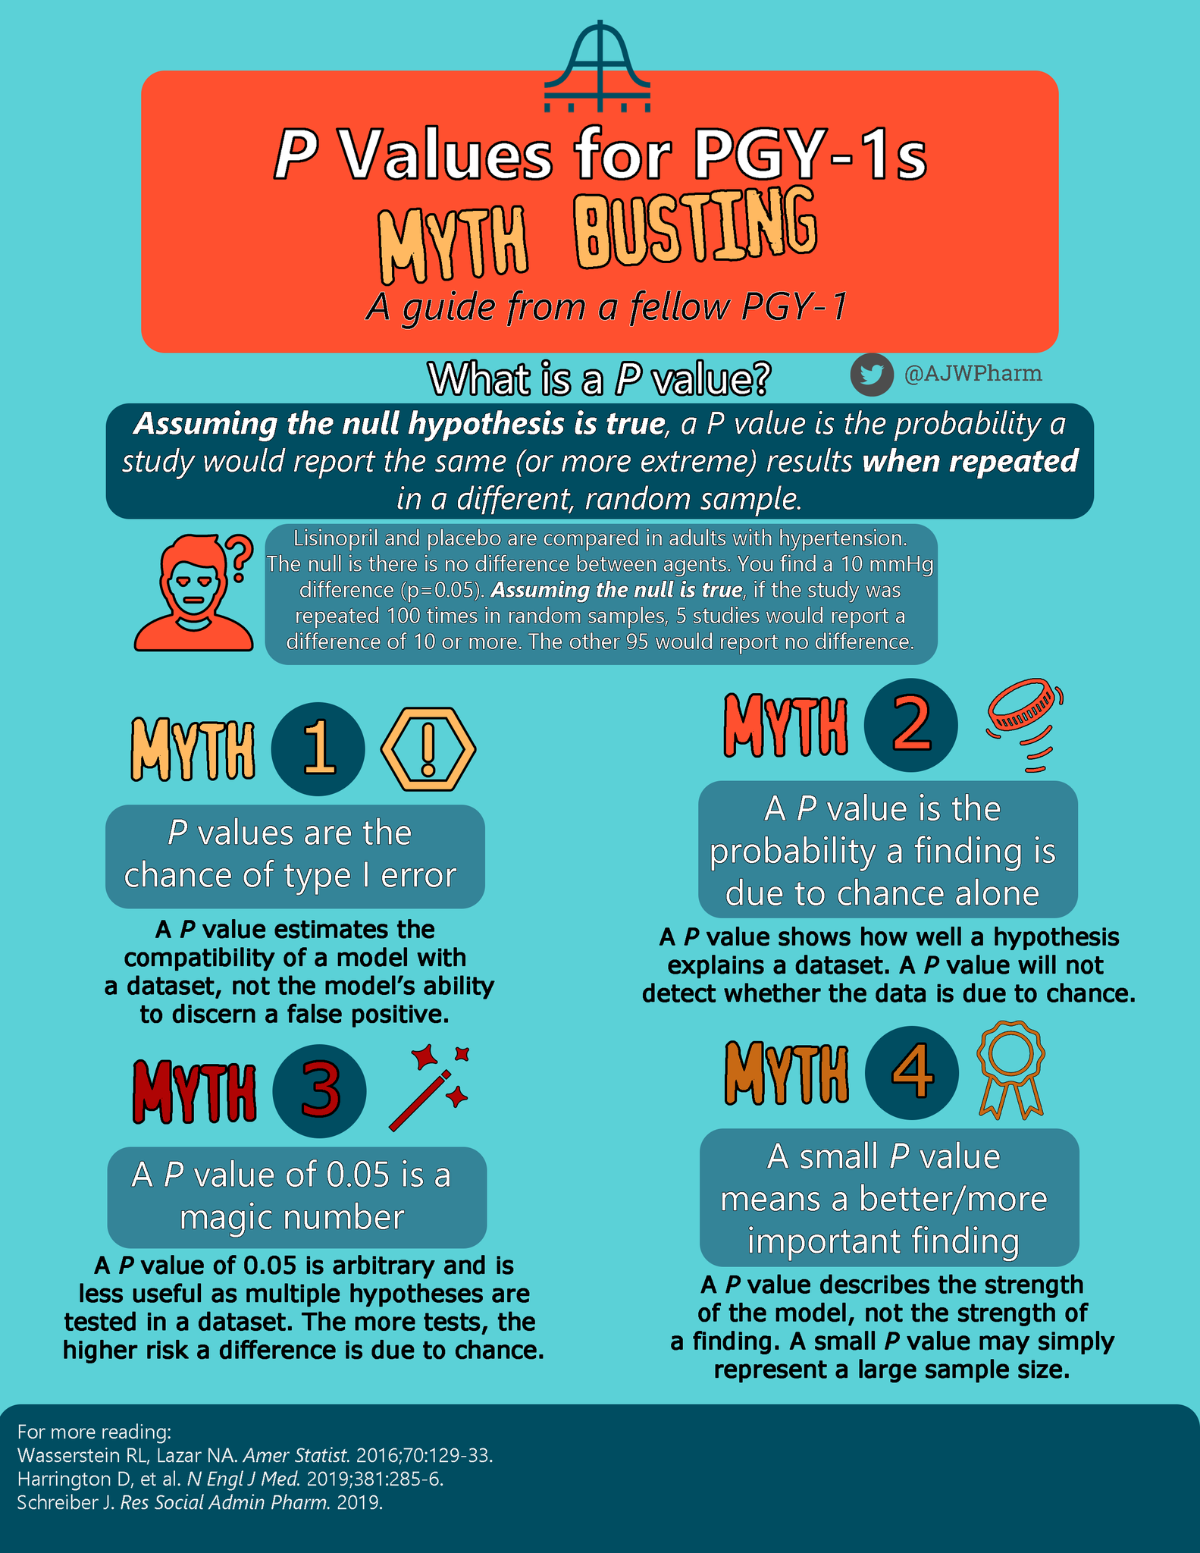
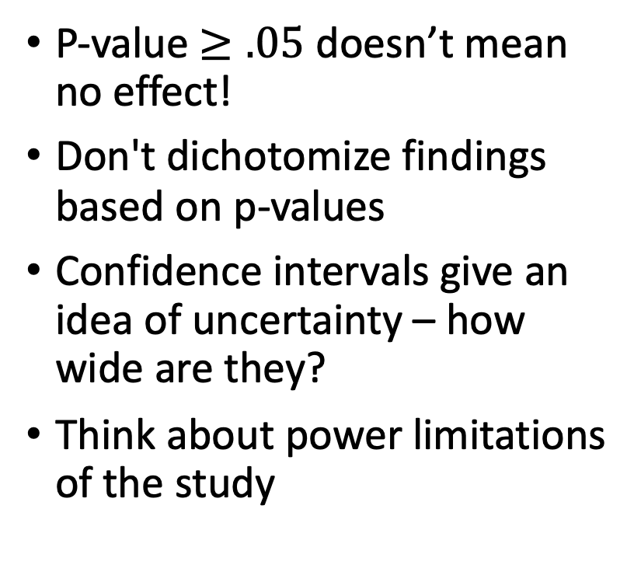
Interpreting Results
P-value $≥.05$ doesn’t mean no effect!
Don't dichotomize findings based on p-values
Confidence intervals give an idea of uncertainty – how wide are they?
Think about power limitations of the study
Andy Webb PharmD on Twitter 2019

Slide 36
Reporting Results
Report confidence intervals
Don’t dichotomize findings – use CIs
Report prespecified vs exploratory analyses
https://rpkgs.datanovia.com/survminer/reference/ggforest.html

Slide 37
There’s Always More Out There…
Non-linear effects
Evaluating biomarker efficacy
Validating prediction models
Data reduction strategies
Modeling in high dimensional spaces
Simulation experiments and power calculations
Randomized controlled trial design
Multiple comparisons correction
Data visualization
Ask us if you want more info on any of these topics!

Slide 38
Questions?

Slide 39
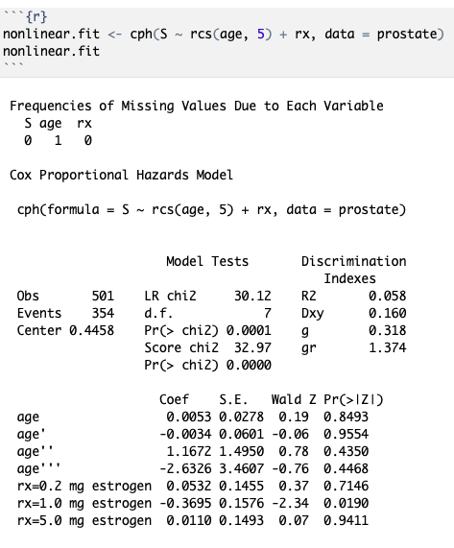
Modeling Nonlinear Effects
Restricted cubic splines relax linearity assumptions
Use rcs() function in R
Number of knots determine how well spline fits data
Use 3 to 5 knots depending on how much data you have

Slide 40
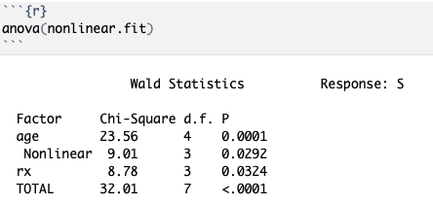
Interpreting (Non-linear) Cox Model
Use anova() to test if variable is associated with prognosis
Only gives p-value not effect size
Need to plot predictor vs HR for nonlinear variables to see effect

Slide 41
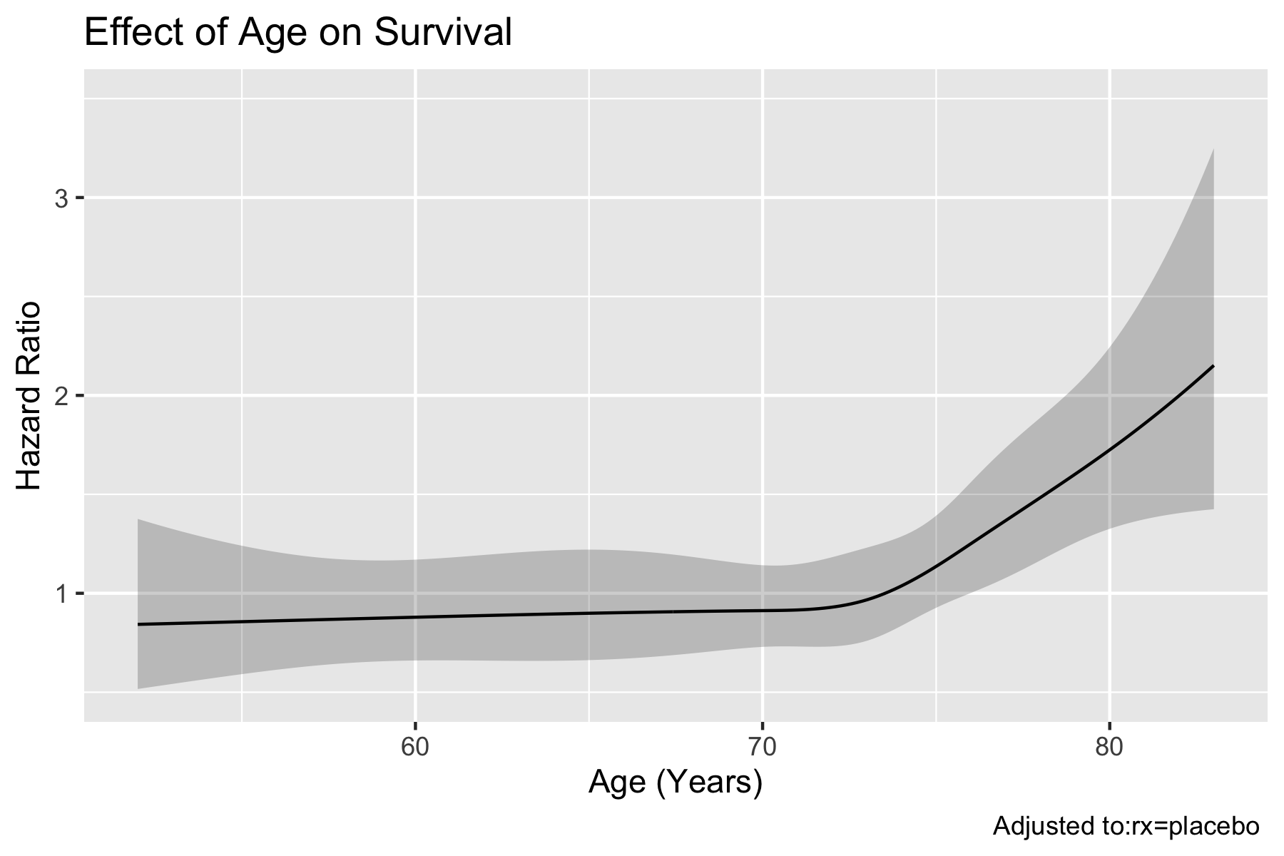
Plotting Predictor vs HR
HR = 1: No difference
HR < 1: Better survival
HR > 1: Worse survival
Beware HR vs ln(HR) scale

